Slide 1
UTILISING COVISITATION BEHAVIOURS AND DENSE RATING FOR MALICIOUS INJECTION ATTACK DETECTION

Slide 2
ABSTRACT:-
Recommender systems have become an essential component in a wide range of web services. It is believed that recommender systems recommend a user items (e.g., products on Amazon) that match the user’s preference. Now a days, a serious a part of everyone trusts on content in social media like opinions and feedbacks of a subject or a product. The liability that anyone can begin a survey provides a brilliant chance to fake co-visitations to compose spam surveys about products and services for various interests. Recognizing these fake co-visitations and therefore the fake content may be a wildly debated issue of research and in spite of the very fact that a powerful number of studies are done as lately toward this end, yet thus far the procedures set forth still scarcely distinguish fake reviews, fake co-visitations, and none of them demonstrate the importance of every extracted feature type. During this investigation, we propose a completely unique structure, named Fake review detection system, which uses spam highlights for demonstrating review datasets to style fake co-visitations detection method into a classification issue in such networks. Utilizing the importance of fake features help we to accumulate better outcomes regarding different metrics on review datasets. We also discuss strategies to mitigate our attacks.

Slide 3
EXSISTING SYSTEM | PROPOSED SYSTEM
Recommender systems have become an essential component in a wide range of web services. It is believed that recommender systems recommend a user items (e.g., products on Amazon) that match the user’s preference. Now a days, a serious a part of everyone trusts on content in social media like opinions and feedbacks of a subject or a product. The liability that anyone can begin a survey provides a brilliant chance to fake co-visitations to compose spam surveys about products and services for various interests. Recognizing these fake co-visitations and therefore the fake content may be a wildly debated issue of research and in spite of the very fact that a powerful number of studies are done as lately toward this end, yet thus far the procedures set forth still scarcely distinguish fake reviews, fake co-visitations, and none of them demonstrate the importance of every extracted feature type. During this investigation. | During this investigation, we propose a completely unique structure, named Fake review detection system, which uses spam highlights for demonstrating review datasets to style fake co-visitations detection method into a classification issue in such networks. Utilizing the importance of fake features help we to accumulate better outcomes regarding different metrics on review datasets. We also discuss strategies to mitigate our attacks.
EXISTING ALGORITHM:- Binary search | PROPOSED ALGORITHM:- guilt-by-association method on directed graphs

Slide 4
ALGORITHM DEFINITION:- | ALGORITHM DEFINITION:-
In this article, we will discuss the Binary Search Algorithm. Searching is the process of finding some particular element in the list. If the element is present in the list, then the process is called successful, and the process returns the location of that element. Otherwise, the search is called unsuccessful. Binary search is the search technique that works efficiently on sorted lists. Hence, to search an element into some list using the binary search technique, we must ensure that the list is sorted. Binary search follows the divide and conquer approach in which the list is divided into two halves, and the item is compared with the middle element of the list. If the match is found then, the location of the middle element is returned. | In this work, author propose GANG, a guilt-by-association method on directed graphs, to detect fraudulent users in OSNs. GANG is based on a novel pairwise Markov Random Field that we design to capture the unique characteristics of the fraudulent-user-detection problem in directed OSNs. In the basic version of GANG, given a training dataset, we leverage Loopy Belief Propagation (LBP) to estimate the posterior probability distribution for each user and uses it to predict a user’s label.

Slide 5
DRAWBACKS:- | ADVANTAGES:-
System can participate in the reading, writing, verification and consensus process of data. The development of Internet technology and the Internet + financial industry. Factors affecting and also restricting and also restricting financial activites have become more complex. | Can participate Development Affecting and retricting

Slide 6
MINIMUMSYSTEM REQUIREMENTS
HARDWARE REQUIREMENTS
PROCESSOR : DUAL CORE 2 DUO.
RAM : 2GB DD RAM
HARD DISK : 250 GB
SOFTWARE REQUIREMENTS
FRONT END : J2EE (JSP, SERVLET)
BACK END : MY SQL 5.5
OPERATING SYSTEM : WINDOWS 7
IDE : ECLIPSE

Slide 7
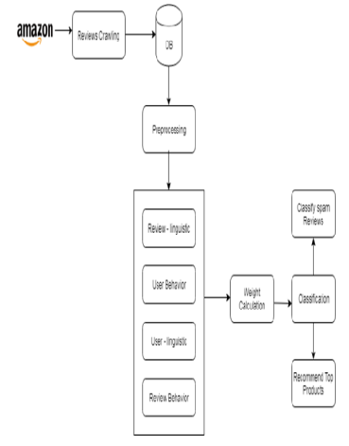
System Architecture

